Slide 1
Css hints by ahmed Mohamed samir

Slide 2
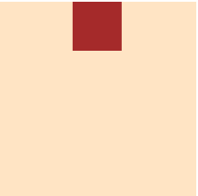
.container::before{
content: "";
background-color: brown;
width: 50px;
height: 50px;
position: absolute;
z-index: 0;
left: 50%;
transform: translateX(-50%);
}
/* you can't make hover on the
pseudo elements ::before and ::after */
.container::before:hover{
transition: all 2s ease-in-out;
background-color: green;
cursor: pointer;
}

